Slide 1
Microcontrollers

Slide 2
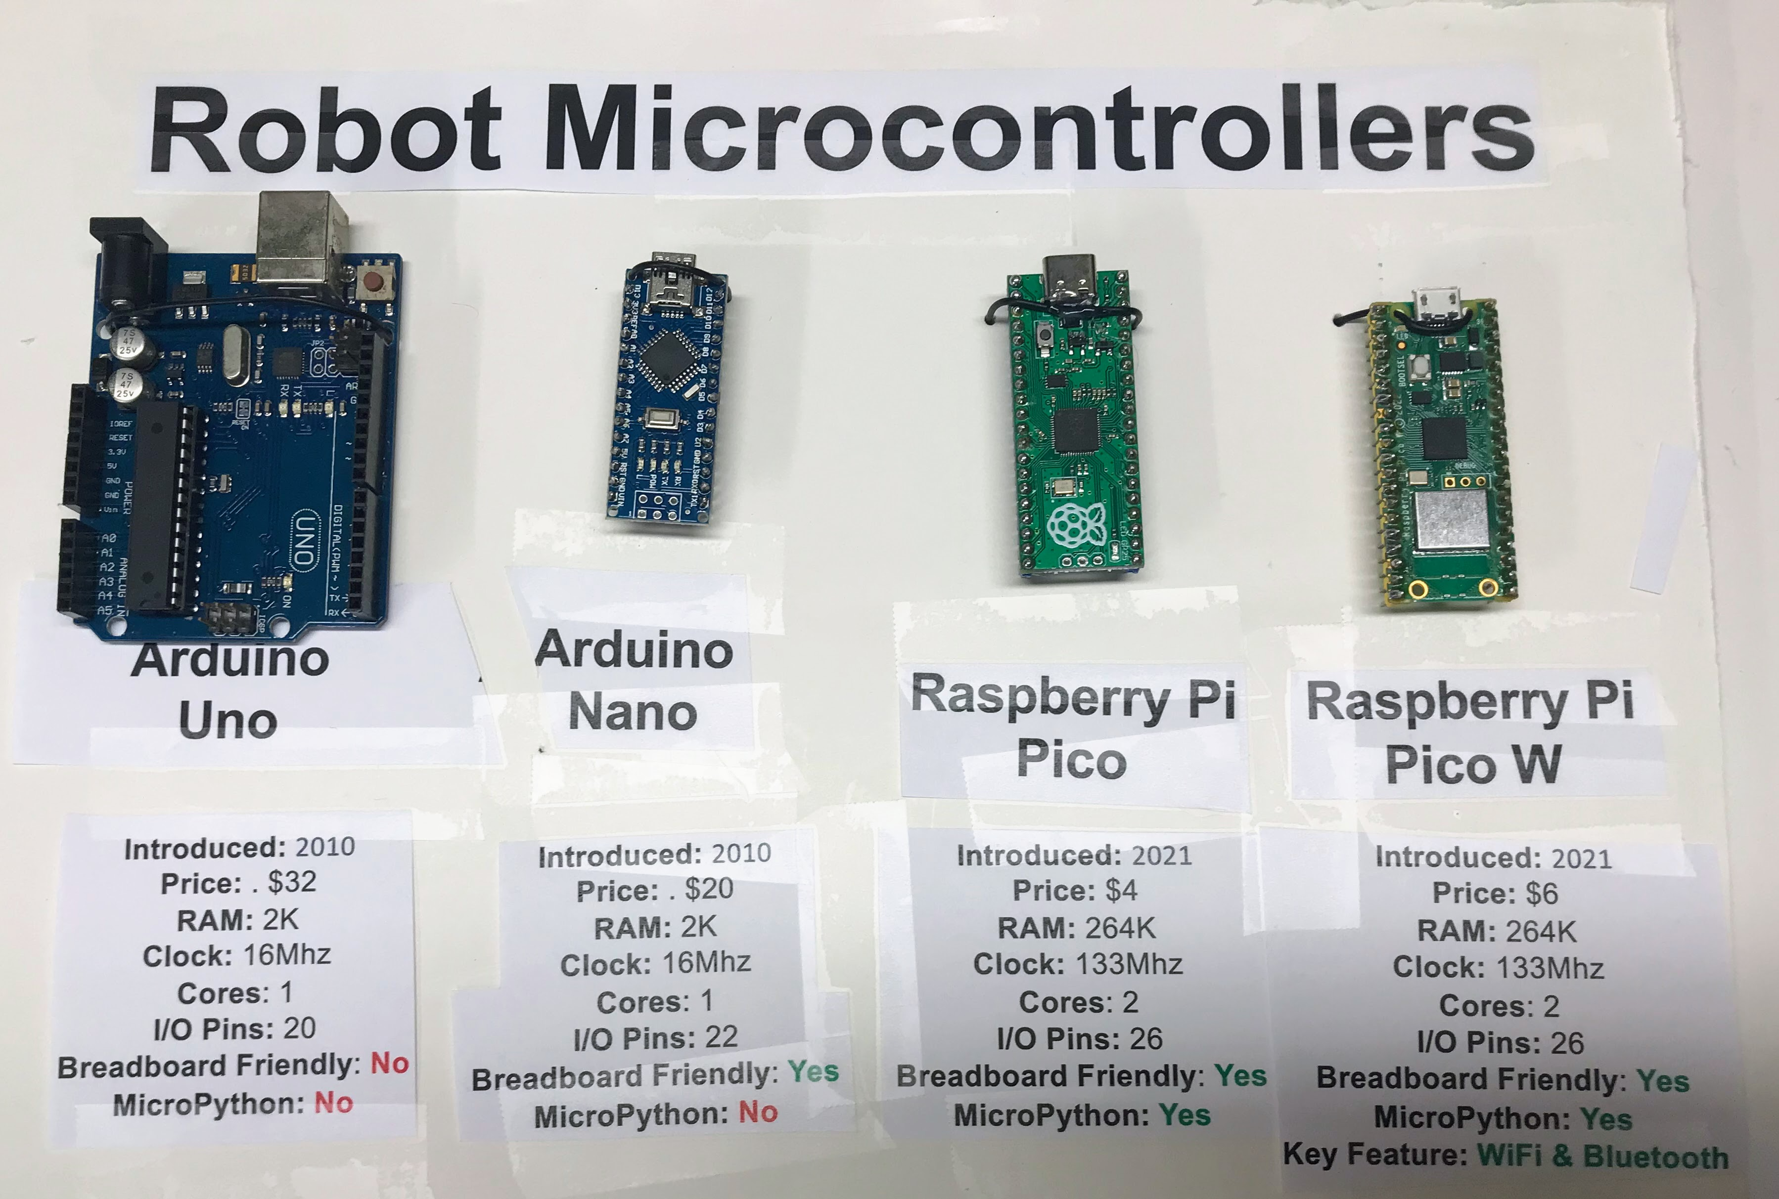

Slide 3
Each square represents 1K of RAM
Raspberry Pi Pico
264K RAM
Arduino Uno
2K RAM

Slide 4
Each square represents 1K of RAM
Raspberry Pi Pico 264K RAM
128x64 Monochrome
Framebuffer 1K
Python
Interpreter
16K
256-character 8x12
Font library = 3K
240x240 16-bit framebuffer
for Smartwatch
112.5K

Slide 5
Clock Speed Comparison
Arduino: 16 MHz
Raspberry Pi Pico: 133 MHz

